Slide 1
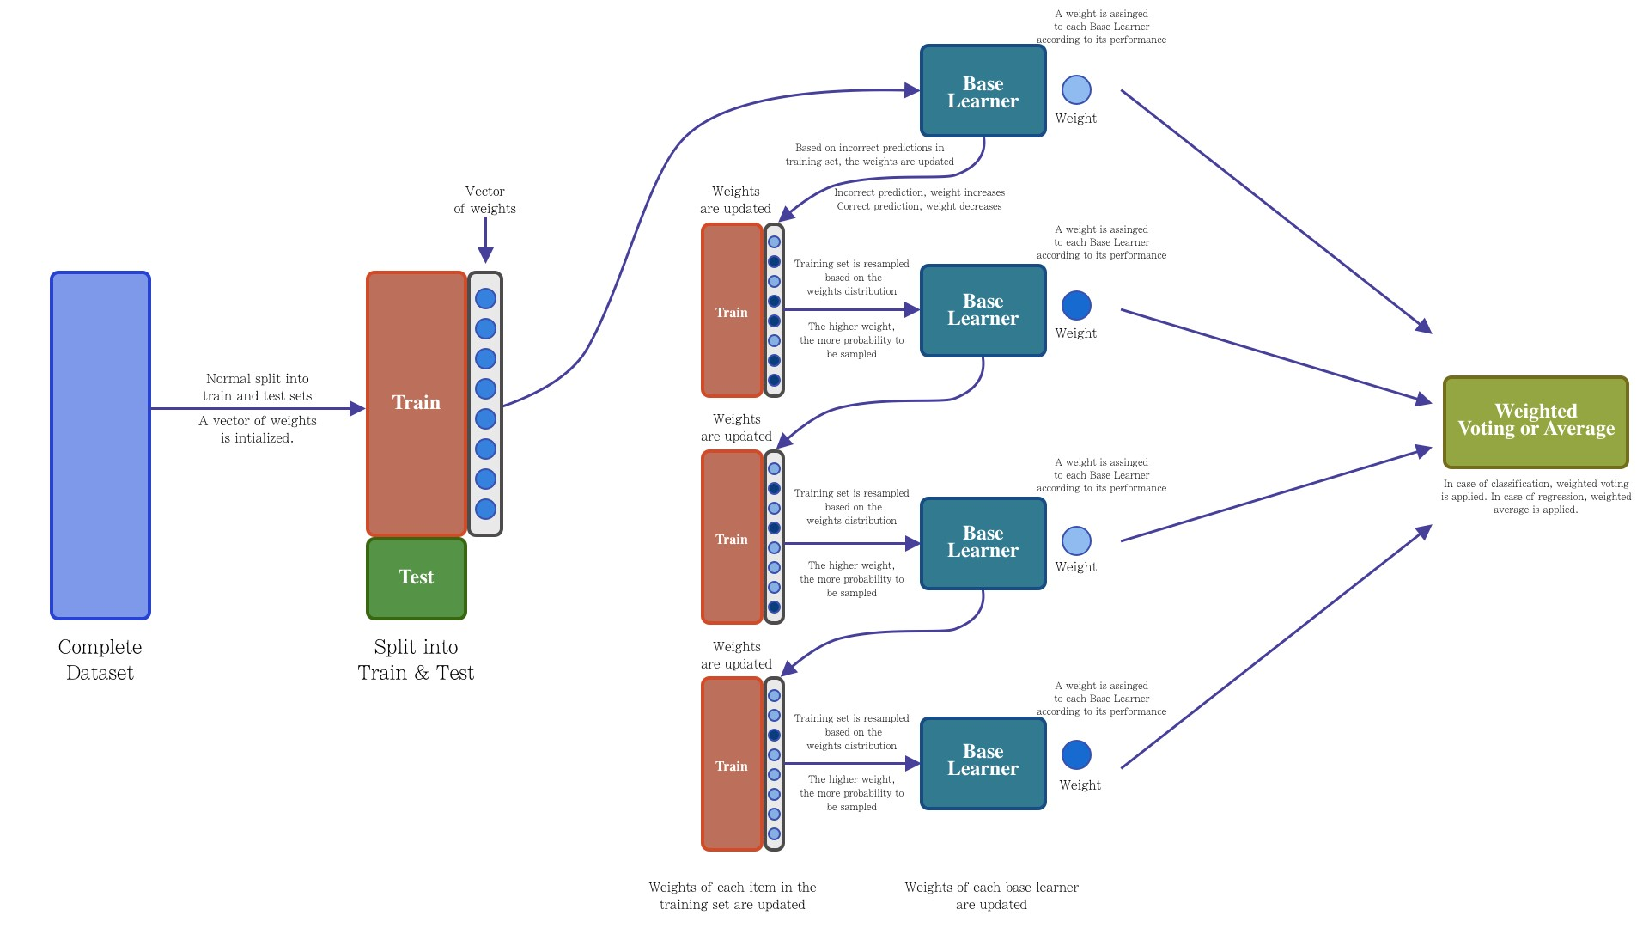

Slide 2
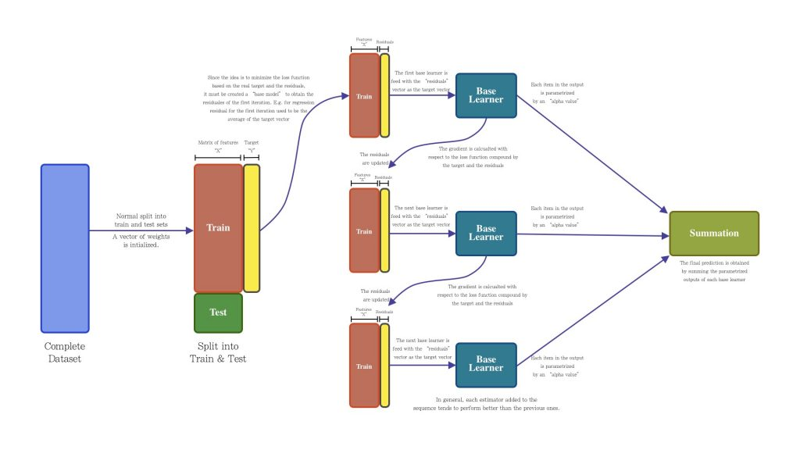
https://resources.experfy.com/ai-ml/ensemble-learning-bagging-boosting/

